Slide 1
Telling Your Program’s Story: Check-in and Networking
What is one story about your program that makes you smile to tell it?

Slide 2
Telling Your Program’s Story: Data Basics
May 12, 2016
Introductory Workshop
Notes:
Good Afternoon!
For those of you that don’t know us. I am Tina Ughrin and this is John Ughrin. We are partners in Smile Minded Smartworks. We are very excited to kick off this first workshop in our series. Telling Your Program’s Story: Data Basics.
I hope you all had a chance to grab a cup of coffee and some of the delicious cookies from Sweet Mary’s.
I loved hearing some of your stories as we were checking in. Would one of you like to share a story you heard this afternoon from another program?
Great example! Thanks! We are going to get started.

Slide 3
Telling Your Program’s Story: Data Basics Workshop Overview
2:00 to 2:30 Check-in and Networking
2:30 to 3:00 Telling Your Program’s Story: Audiences
3:00 to 3:30 Communicating Data to Partners and Funders
(Guests: Matt Deevers & Cristina Gonzalez Alcala from Summit Education Initiative)
3:30 to 4:45 Structuring Data to Better Tell Your Program’s Story
Notes:
This afternoon, we will concentrate on three key aspects of Telling Your Program’s Story. We will start with a foundation in what your audiences need to know about your program. We will then be joined by Matt Deevers and Cristina Gonzalez Alcala to hear their suggestions based on their expertise and experience with communicating with data to partners and funders. Finally, we will get into the weeds of dealing with some of the frustrations we all have in structuring data to better tell our program’s stories.
Just a few housekeeping notes. We will not be taking any formal breaks, so feel free to grab another cookie, water, or step out to restroom which is across hall as needed. Also, four participants will be joining us at 3:00. I just don’t want you to be too surprised when our class suddenly grows.

Slide 4
Telling Your Program’s Story: Member Sign in
www.smileminded.com
Click Register
Fill out the form.
We will approve your registration and then you can access the Workshop Member Content
Notes:
As our workshop is just a few short hours and we want to be sure that you leave with the tools you need to implement what you learn when you are back at your desk, we have added a Members section to our website.
This will give you access to the data we will use today, the power point, and some additional resources. Please click on the link and register. When you are done registering, if you can look up at the front of the class, we will know you are done and can approve everyone’s registration.
Great! You will note that in the Members section, there is a Power Point Presentation.
Also in the Members section there are several Excel files. Please download the file labeled Classwork Version. We will be using that file later this afternoon. The other is labeled Homework. The Homework file is for you to use after the workshop to practice what you have learned.
Finally, there are handouts that go into more detail for you to access after the workshop.

Slide 5
Telling Your Program’s Story: Data Fundamentals Workshop Series
Evaluation Goals
Data Identification
Data Collection
Data Management
Data Analysis
Reporting
Evaluation Goals Who is your audience and what do they need to know about your program?
Data Identification What data do you need?
Data Collection How do you collect and document your data?
Data Management How do you structure data?
Data Analysis How do you find patterns in the data?
Reporting How do you report your findings to multiple stakeholders?
Notes:
Today’s workshop is the first in a series we will be offering both face to face and online.
We will begin today by exploring who are your audiences and what do they need to know about your program. We will then look at how you structure your data to best communicate your data internally and with partners.
Other workshops will explore what data you need to collect, how to collect , analyze, and report that data. We will have both introductory workshops (like today) and more advanced workshops.
At the end of our workshop today, we will ask you to complete a survey about what worked and what else you would like to see offered.

Slide 6
Telling Your Story: Today’s Workshop
What is the program story you hope to tell?
What do your partners and funders need to know from your program’s story?
How can you structure your data to make telling your story easier?
Notes:
As I mentioned, we will be answering the following questions:

Slide 7
Telling Your Story: Your Audience
Staff and Volunteers (Celebrating & Course Correcting)
Donors and Foundations (Succeeding & Sustaining)
Community (Reaching & Engaging)
Notes:
Telling Your Program’s Story can take several forms depending on your audience. It is tempting to collect information for one audience to be used for other audiences. While the questions that you ask and the data that you collect for each audience will have overlap, the needs of each audience are distinct. We can better reach each audience if we are intentional about addressing each audience

Slide 8
Your Audience: Staff & Volunteers (Celebrating and Course Correcting)
What are the goals & objectives of our program?
What do we hope to accomplish?
What resources (inputs) are available to reach those goals and objectives?
Who benefits from our program?
What do we need to know about our clients/participants to better serve them with our program?
What resources (inputs) are limited and may impact our ability to reach our goals and objectives?
What is working? What is not working?
Do we know why somethings are working or not working?
Notes:
Your first audience is internal – your staff and volunteers. This audience helps you to celebrate your program’s successes but also course correct. Ideally, as your program is unfolding, you will monitor whether you are meeting your goals and objectives, implementing resources wisely and efficiently, gathering what you need to know about your participants/clients to better serve them and making adjustments to the program as you evaluate what is and what is not working. Asking key questions can help you work with your staff and volunteers to engage in formative (on-going or continuous) evaluation.
Any questions on Staff & Volunteers?

Slide 9
Your Audience: Donors & Foundations (Succeeding and Sustaining)
Notes:
Your second key audience are your donors and funders. This audience is most interested in whether you are succeeding and if you are sustainable. Typically, funders look for summative evaluation (end of the grant, end of the year, etc.).
Traditionally, they have asked programs to track and report on summative evaluation through a logic model. This is one version of a logic model. The reference and more information about the logic model are in the handouts in the Member section of the website.
This model is still expected by many funders. Although a few are moving toward new models of evaluation including collective impact. Future workshops will explore these models in more detail.
For our purposes today, what is key to note is that the logic model includes providing background and context in terms of the situation or gaps the program addresses, inputs (resources invested), outputs (who is served and how), and outcomes (what are the short, medium, and long term impacts).

Slide 10
Your Audience: Donors & Foundations (Succeeding and Sustaining)
Background and Context
What is the landscape in which your program is situated? What assumptions are you making?
Outputs
(Activities & Participation)
What is your program?
Outcomes (Impact)
Why was your program created? What gap does it fill?
What are the top 3 priorities of your program?
What are the goals and objectives of your program?
What are the activities of your program?
Who participated in your program? How many and how often?
Inputs (Investments)
What funding and resources are part of your organization budget that will support this program?
What additional funding and resources are needed outside of your organization’s budget?
How efficient are you with funding and resources?
What are the short term outcomes? How will you measure knowledge and perceptions of participants?
What are the medium term outcomes? What are some interim measures of impact?
What are the long term outcomes? How will you measure success? How will you measure barriers to success?
What external factors impact your program? How do you adjust to those factors?
Notes:
You will note that the questions for donors and foundations are far more detailed than those for our staff and volunteers. Funders are not part of the day to day happenings of your program. For funders to evaluate your success and how well you can sustain the work, they need more detailed information.
You have examples of these questions and more information in the handouts in the Member section of the website. We will also be exploring what data to collect as well how to collect, analyze, and report on the data in future workshops.
Any questions about Donors & Funders?

Slide 11
Your Audience: Community (Reaching & Engaging)
What is the niche our program serves?
Who participates or is served by our program?
How are they served?
What are some key impacts of our program?
What stories of participants or clients best illustrate the impact of our program?
Notes:
Finally, the community as an audience includes potential participants and clients as well as the larger community who may not be familiar with your program.
You will note that all three audiences include questions around the context/gap/niche the program addresses, who benefits from the program, and how the program is provided, and what are the outcomes of the program.
For the community, the way in which this data is shared though differs as it is less about evaluation (formative or summative) and more about reaching and engaging the public.
You may use data you collect for internal and funder audiences, but it needs to be contextualized in the stories of participants or clients. Any statistics shared should also be simple and ideally include a graphic to illustrate them.
Any questions about the Community?

Slide 12
Telling Your Program’s Story: Data Fundamentals Workshop Series
Evaluation Goals
Data Identification
Data Collection
Data Management
Data Analysis
Reporting
Evaluation Goals Who is your audience and what do they need to know about your program?
Data Identification What data do you need?
Data Collection How do you collect and document your data?
Data Management How do you structure data?
Data Analysis How do you find patterns in the data?
Reporting How do you report your findings to multiple stakeholders?
Notes:
As I mentioned earlier this afternoon, we will be building workshops around all of the steps of program evaluation. We be offering varying levels and both face to face and online versions.

Slide 13
Telling Your Story: Working with Partners & Funders
Matthew Deevers, Ph.D.
&
Christina Gonzalez Alcala, M.S.
Summit Education Initiative
Notes:
I am excited to introduce you to Matt Deevers and Cristina Gonzalez Alcala from Summit Education Initiative. Many of you are familiar with their work, but for those of you that are not, Summit Education Initiative (SEI) is a nonprofit organization working to enhance the educational experiences of individuals and their families living in Summit County.
Matt and Cristina work closely with Summit County schools, organizations, and programs to:
Use data to identify specific issues that require attention
Mobilize our five strategy teams
Measure progress and success
Report findings
Scale successful strategies across the county
They have joined us today to share their expertise and experience working with scores of schools, organizations, and agencies.
Let’s give them a warm welcome.

Slide 14
Telling Your Program’s Story: Member Sign in
www.smileminded.com
Click Register
Enter your email, first name, and last name
We will approve your registration and then you can access the Workshop Member Content
Notes:
Thank you so much Matt and Cristina. Can we give them one more round of applause!
For those of you who just came in, please go to our website and register. John will approve your registration. You will then need to download the Excel data set entitled Classwork Version.
The PP is also available as well as handouts and some additional data sets.

Slide 15
Telling Your Story: How can you structure your data to make telling your story easier?
Notes:
We are now going to explore how you can structure your data to make telling your story easier.
We will start by defining a few terms and then we will look at some tips on the use of spreadsheets for your structuring your data.

Slide 16
Telling Your Story: Data Management Basics
Data
Data Collection
Data Management
Spreadsheet vs. Databases
Notes:
Just to be sure we are on the same page. We are going to define a few terms briefly.
Data -- information
Data Collection – how the information is collected (e.g. attendance sheet, survey, interview…)
Data Management – how the information is stored and structured for sharing and analyzing
Spreadsheet vs. Databases – A spreadsheet is a flat file with columns and rows for data. A database has multiple files (tables) that can be linked to one another relationally.

Slide 17
Telling Your Story: Data Management Basics
Documentation
Standardization
Atomization
Manipulation Techniques
Notes:
We have divided our tips and suggestions for structuring your program data into four areas.
Documentation – recording and sharing data choices
Standardization -- Consistent entering and labeling of data
Atomization -- Breaking data into the smallest logical unit
Manipulation Techniques -- Basic changes to data to better understand or display information

Slide 18
Telling Your Story: Data Management Basics
Documentation
Recording and sharing data choices
Documentation includes a running record or protocol for data:
Sources (who, what, when, and where of data collection)
Codes (abbreviations, acronyms, etc.)
Manipulations performed (how was the data changed in the spreadsheet)
Analysis choices (statistics, graphs, etc.)
Incidental (Anything else that someone who picks up this dataset needs to know to pick up where you left off)

Slide 19
Telling Your Story: Data Management Basics
Documentation
Recording and sharing data choices

Slide 20
Telling Your Story: Data Management Basics
Standardization
Consistent entering and labeling of data
Data Entry Protocols
Data Collection (e.g. birthday vs. age)
Organizational Procedures
Data Entry Restrictions
Data Storage Protocols
Avoid Formatting for Presentation (inline headers, merging cells, etc.)
Unique IDs

Slide 21
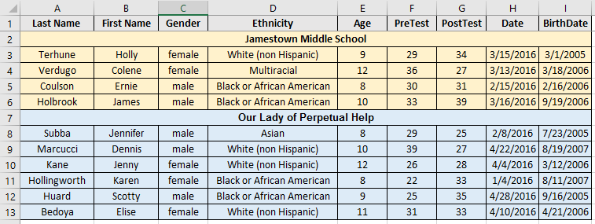
Telling Your Story: Data Management Basics
Standardization
Consistent entering and labeling of data
Data Entry Protocols

Slide 22
Telling Your Story: Data Management Basics
Standardization
Consistent entering and labeling of data
Data Entry Protocols

Slide 23
Telling Your Story: Data Management Basics
Standardization
Consistent entering and labeling of data
Data Entry Restrictions

Slide 24
Telling Your Story: Data Management Basics
Standardization
Consistent entering and labeling of data
Unique ID

Slide 25
Telling Your Story: Data Management Basics
Atomization
Breaking data into the smallest logical unit
Data should be broken into the smallest logical units
(e.g. last name, first name, address)
It is possible to break data into illogical units
(e.g. male – yes/no, female – yes/no rather than gender – male/female)
Data should be collected to be as flexible as possible (e.g. age or birthdate vs. age category such as “18-24”)

Slide 26
Telling Your Story: Data Management Basics
Atomization
Breaking data into the smallest logical unit
Data should be broken into the smallest logical units

Slide 27
Telling Your Story: Data Management Basics
Atomization
Breaking data into the smallest logical unit
Data should be broken into the smallest logical units

Slide 28
Telling Your Story: Data Management Basics
Atomization
Breaking data into the smallest logical unit
It is possible to break data into illogical units
(e.g. male – yes/no, female – yes/no rather than gender – male/female)

Slide 29
Telling Your Story: Data Management Basics
Atomization
Breaking data into the smallest logical unit
Data should be collected to be as flexible as possible
(e.g. age or birthdate vs. age category such as “18-24”)

Slide 30
Telling Your Story: Data Management Basics
Manipulation Techniques
Basic changes to data to better understand or display information
Freezing Columns and Rows
Sorting
Filtering
Using Pivot Tables
Inserting Columns and Rows
Making Basic Calculations
Utilizing Functions

Slide 31
Telling Your Story: Data Management Basics
Manipulation Techniques
Basic changes to data to better understand or display information
Freezing Columns and Rows

Slide 32
Telling Your Story: Data Management Basics
Manipulation Techniques
Basic changes to data to better understand or display information
Sorting

Slide 33
Telling Your Story: Data Management Basics
Manipulation Techniques
Basic changes to data to better understand or display information
Filtering

Slide 34
Telling Your Story: Data Management Basics
Manipulation Techniques
Basic changes to data to better understand or display information
Using Pivot Tables

Slide 35
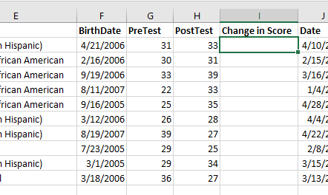
Telling Your Story: Data Management Basics
Manipulation Techniques
Basic changes to data to better understand or display information
Inserting Columns and Rows

Slide 36
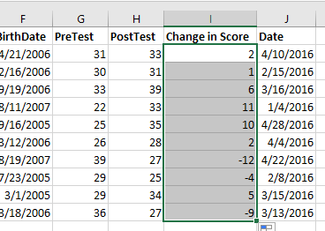
Telling Your Story: Data Management Basics
Manipulation Techniques
Basic changes to data to better understand or display information
Making Basic Calculations

Slide 37
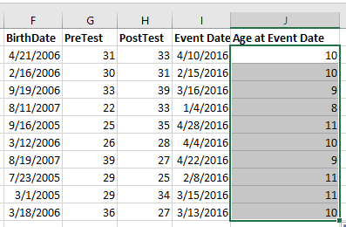
Telling Your Story: Data Management Basics
Manipulation Techniques
Basic changes to data to better understand or display information
Utilizing Functions

Slide 38
Telling Your Story: What’s Next?
Homework Data Set
Handouts
Evaluation and Future Workshop Survey

